Slide 1
?
A
B
C
Fixed wheel
Turnable wheel
Heading

Slide 2
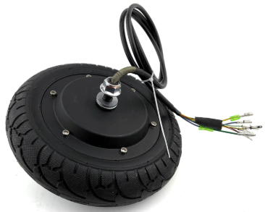
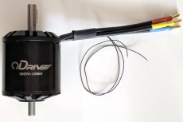
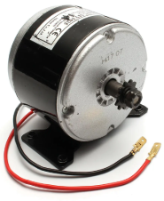
?
A
B
C
Brush less Hub motor
Brush less normal dual shaft
Brushed motor
(feilds highlighted in blue are inputs) | kv | Max current | Max voltage | price | Weight | Link | Torque | No-load speed |  |  | Force | Acceleration | Time to base speed | distance to base speed | Power at base speed | Base speed kinetic energy | Encoder freq. (base speed)
 | rpm/v | A | V | USD | g |  | Nm | rpm | rad/s | m/s | N | m/s^2 | ms | mm | W | J | kHz
ODrive Robotics D6374 - 150kv | 150 | 70 | 48 | 99 | 890 |  | 3.86 | 5760 | 603.19 | 5.76 | 404.15 | 134.87 | 42.71 | 123.00 | 2328 | 31.52 | 196.608
70*48=3360W

Slide 3
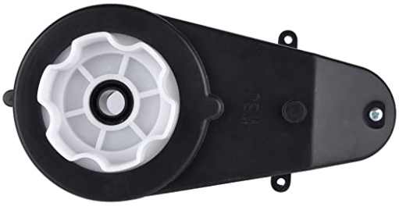
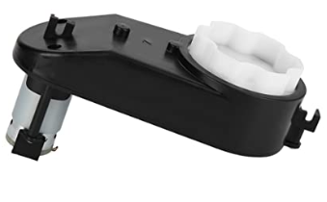

Slide 4
Battery
Controller
Solar panel
Electric block diagram
Pixhawk
Flight controller
Jetson Nano
Electronic compass
Acceleration
Camera
Not sure
10W
Motor controller
Motors
GPS
10W

